Slide 1
Terrain

Slide 2
Several terrain system options
Heightmap-based
The traditional approach
Voxel-based
Minecraft
Useful in grid-based games
Mesh-based
One (or usually many) large models

Slide 3
Some pros and cons
 | Pros | Cons
Height map | Easy to procedurally create Easy to procedurally LOD Can use simplified physics Fairly low memory usage | Less control of shape No “doubled over” terrain No cliffs, caves, etc.
Voxel | Easy to update in real time Can have cliffs, caves, etc. | Large amount of data Rendering can be slow
Mesh | Fast to render Artists have complete control Can have cliffs, caves, etc. | Hard to procedurally LOD Collision can be slow Hard to update

Slide 4
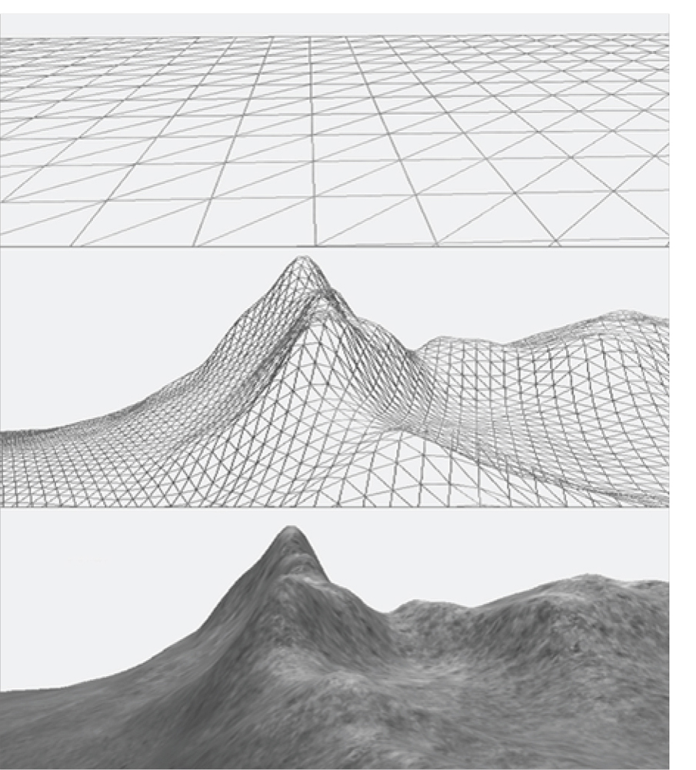
Heightmaps: The traditional approach
Usually rendered as a grid of triangles
The height of each vertex can be determined:
At load time – basically baked into the vertices
In a shader – allows the grid to change dynamically

Slide 5
Terrain vertices
Generally starts as a flat grid
Vertices are raised from their default position
They only move straight up
Final height could be based on:
A static height map
A procedural algorithm

Slide 6
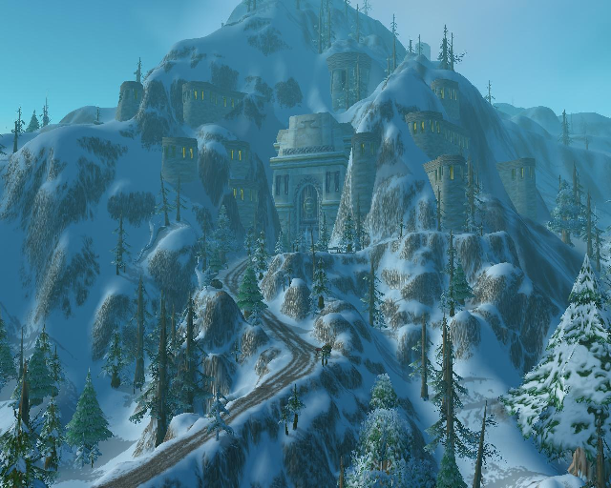
Terrain - Examples
Ironforge exterior from WoW
Notice that the terrain never “doubles over” on itself
Heightmap for the terrain created & textured by artists

Slide 7
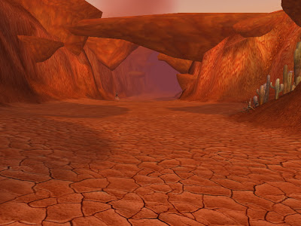
Terrain - Examples
Here it seems like the terrain does fold over itself
That’s what it should feel like
But that’s not how it’s created

Slide 8
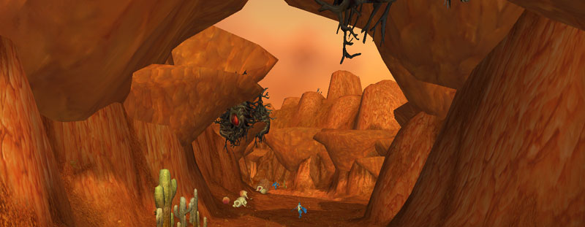
Terrain - Examples
Artists have simply added extra geometry that sticks out of the terrain

Slide 9
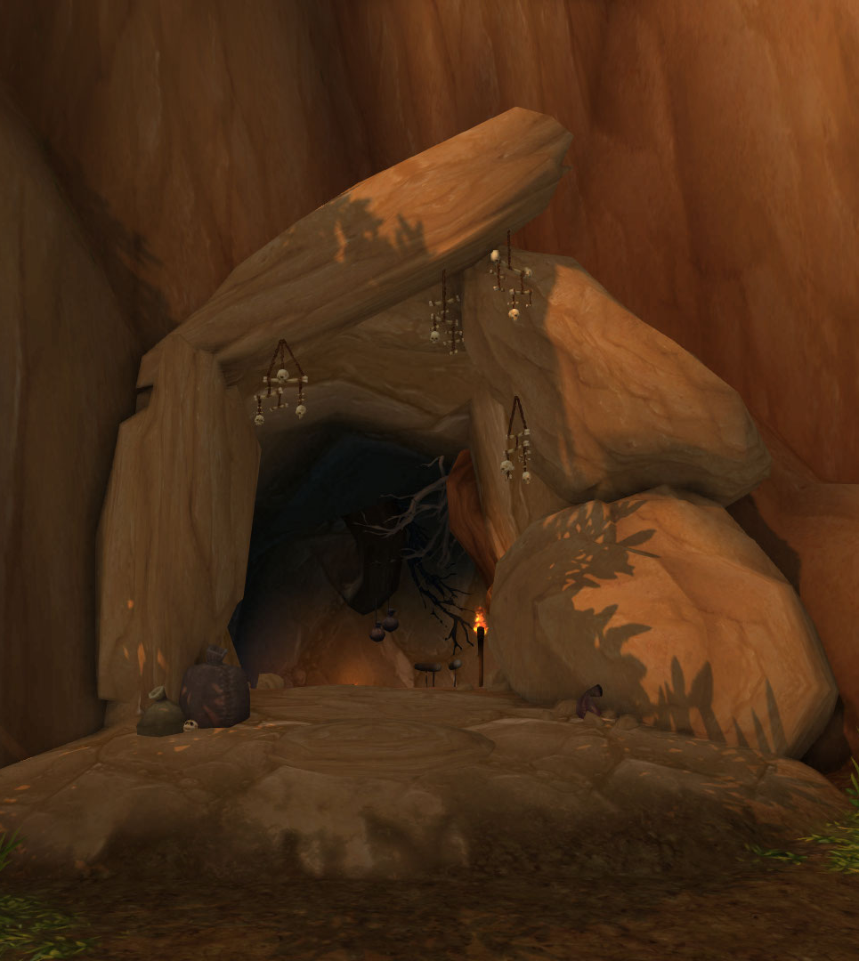
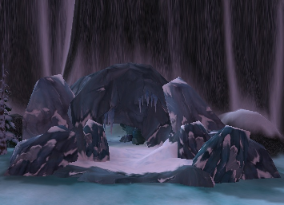
Terrain - Caves
Caves are basically holes cut into the terrain
Triangles left out of the grid
Extra geometry hides ugly edges

Slide 10
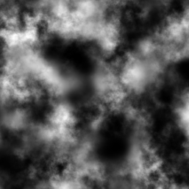
Height maps
Just a texture
Pixels denote heights for particular vertices
512x512 texture = 512x512 vertices
Resulting in 511x511x2 triangles

Slide 11
Height map colors
Usually grayscale
Only need 1 value per vertex (smaller files)
Black = no height
White = full height
Gray = in the middle
Can be created by hand or procedurally

Slide 12
Creating Height Maps
Existing tools:
Terragen - http://www.planetside.co.uk/
World Machine - https://www.world-machine.com/
Photoshop:
Paint a greyscale image
Save as .RAW file
Unity:
Create terrain and export height map

Slide 13
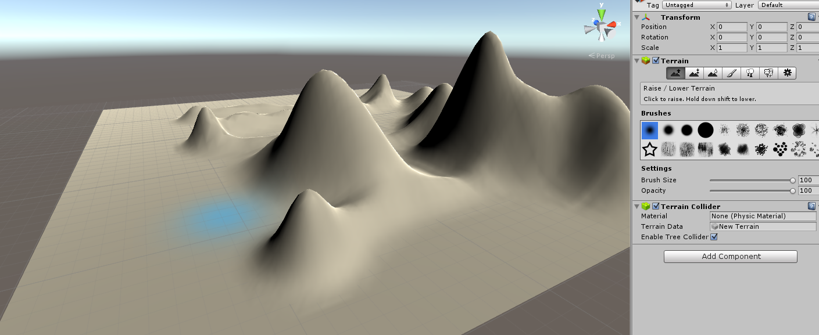
Interactive Heightmap Creation
Unity allows you to “paint” your terrain
You’re actually painting the underlying heightmap
As you paint, Unity updates the terrain live

Slide 14
Photoshop - .RAW files
Image format that simply holds pixel values
No other data at all
No image size information
Greyscale .RAW files
Default to 8 bits per pixel (256 unique value)
A 10x10 .RAW image takes up exactly 100 bytes
Loading a RAW file in code is easy
As long as you already know the size and bit depth

Slide 15
Loading a .RAW file
// Vector to hold heights (assuming 512x512 8-bit image)
std::vector<unsigned char> heights(512 * 512);
// Open the file (remember to #include <fstream>)
std::ifstream file;
file.open(“heightmap.raw”, std::ios_base::binary);
if( file )
{
// Read raw bytes to vector
file.read((char*)&heights[0], 512 * 512); // Same size
file.close();
}

Slide 16
Converting .RAW data
You have a vector of bytes
You probably want float values
In a different range than 0-255
// Copy data to final vector, which you can treat as a 2D array
// (Or you could copy to an actual 2D array instead)
std::vector<float> finalHeights(512 * 512);
for(int i = 0; i < 512 * 512; i++)
{
// “heightScale” is a scale of your choosing
// Again: assuming 8-bit data (values in 0-255 range)
finalHeights[i] = (heights[i] / 255.0f) * heightScale;
}

Slide 17
Heightmap data – Now what?
Procedurally create triangles in a grid
Positions
X & Z values are spaced out equally across the grid
Y values come from your height map data
UV Coords
Also evenly spaced out (0 – 1 over whole grid)
Can support tiling by going outside 0-1 range
0 – N, where N is number of times to repeat

Slide 18
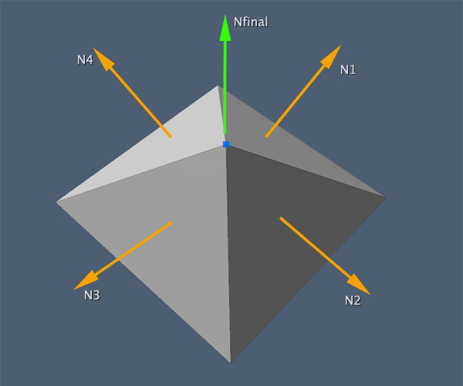
Heightmap normals
Without proper normals, lighting won’t work
Need averaged (smooth) normals
Or you get a “low poly” look
Smooth normals:
1: Calc triangle normals
Triangle ABC = BA x BC
2: Calc vertex normals
Average normals of surrounding triangles

Slide 19
Finalizing and rendering
Put all vertex data into a vertex buffer
Also create a corresponding index buffer
Can help reduce vertex buffer size
Since so many vertices are shared
Render like any mesh
Lighting
Shadows
Etc.

Slide 20
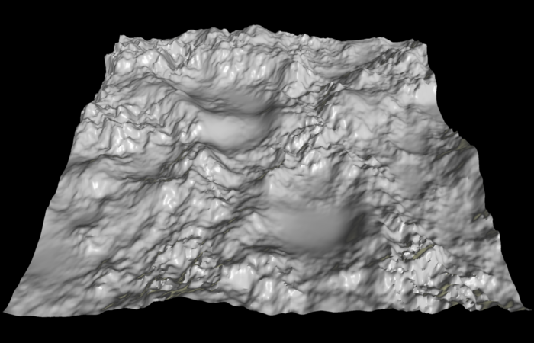
Heightmap results

Slide 21
Multiple heightmaps
A single heightmap/grid is fine for:
A small game
A single, small level
A larger, open-world game will probably have multiple height maps and grids
Sometimes called “patches”
Allows for larger areas
More optimized – only draw what you can see!

Slide 22
Collisions with terrain
Fairly simple
Keep a copy of your height data CPU-side
Determine which triangle you’re on in X/Z grid
For a position in space:
Calculate indices of 4 surrounding grid heights
Determine which of the 2 triangles you’re on
Interpolate heights of triangle’s 3 vertices
(Use barycentric interpolation)

Slide 23
Basic terrain
Those are the steps for creating basic terrain
With a single texture
Which can look alright

Slide 24
Better terrain texturing
Often you want your terrain to have multiple textures
Mountains are rocky
Mountain tops are snowy
Low-lands are grassy
Roads/paths cut through the terrain
Need a way to arbitrarily blend between these textures across the terrain

Slide 25
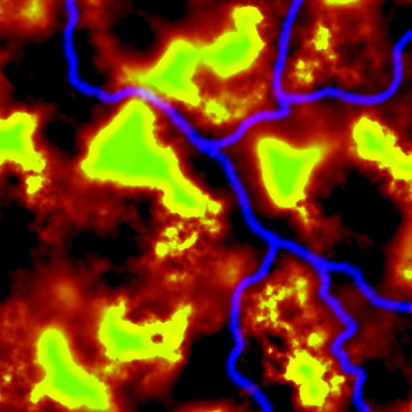
Blend maps
Also known as Splat Maps
Texture that defines how to blend
Each color represents the percent of a texture
Blend in pixel shader
Sample blend map
Sample all textures
Interpolate between textures based on blend percentages

Slide 26
Blend map pixel shader - Sample
// Sample blend map
float4 blend = blendTexture.Sample(…);
// Sample other textures
float4 color0 = texture0.Sample(…);
float4 color1 = texture1.Sample(…);
float4 color2 = texture2.Sample(…);
float4 color3 = texture3.Sample(…);

Slide 27
Blend map pixel shader - Combine
// Final pixel color starts with first color
float4 finalColor =
color0 * blend.r +
color1 * blend.g +
color2 * blend.b +
color3 * blend.a;
// Can also be applied to other maps:
// - Specular maps
// - Normal maps
// - PBR textures

Slide 28
Generating blend maps
Hand-paint in Photoshop
Generate alongside height map
World Machine can do this
Export from interactive tool (Unity)
Blend map exists inside Unity
There’s no “export” button though
Need to write a script to extract and save

Slide 29
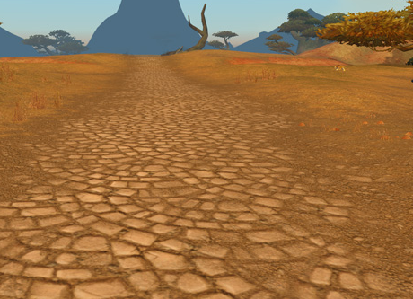
Blend map examples
Why not just make one big texture?
Because Azeroth is HUGE
This allows each texture to repeat

Slide 30
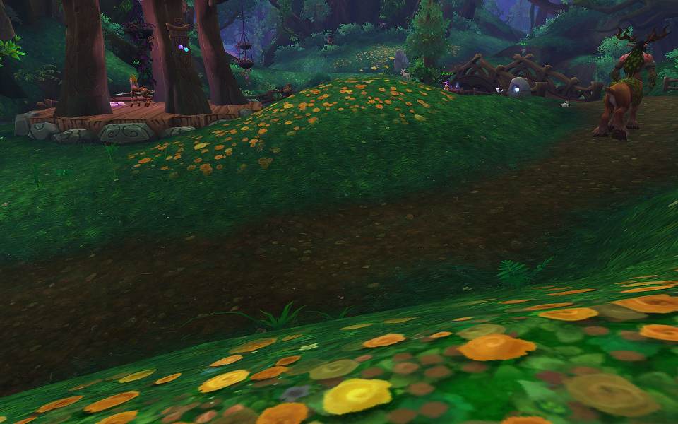
Blend map examples

Slide 31
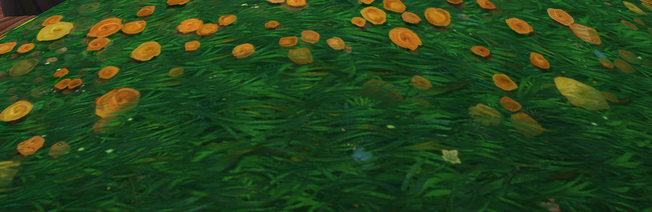
Blend map example – Close up
Notice the flower texture actually blending

